Slide 1
NSM Tools
Security Onion

Slide 2
Theory of NSM
Typically
Log blocked network traffic
Allow other things to flow freely
Backwards
Why?
Where does NSM not work?
Large volumes of data
Encrypted data
More?

Slide 3
NSM’s Value
Post—occurrence value
If we’re 100% secure, NSM is useless
Everyone thinks they are 100% secure, nobody is
NSM: Detect bad things
NSM: Reproduce attackers traces
NSM: What did they do?
What did they steal?
How bad is it?
This informs the rest of the steps as you’re responding

Slide 4
Security Onion
A Linux distribution with various network security monitoring (NSM) tools
Runs on Ubuntu
Security Onion is to NSM as Kali is to pentesting
Security Onion has three major components:
Full packet capture
Intrusion detection systems
Network-based (NIDS)
Host-based (HIDS)
Analysis tools

Slide 5
Let’s Dive In
ialab.dsu.edu
Learn – HTML5
Username: cyberXXX
Password: camper.XXX
Replace XXX with your number
110-145

Slide 6
Security Onion
SO Creds: dsu Password1!
The setup is already complete for you!
But it’s pretty easy

Slide 7
Full Packet Capture
Capture all the things!
Uses netsniff-ng
Captures all the traffic, and stores as much as it can
Security Onion will purge old data before the disks fill up
Having a full capture is like having a recorder on your network
Not for daily monitoring or hunting
There to run down issues or incidents after the fact
Attackers can’t bypass a full capture

Slide 8
Network IDS – Rule Driven
Snort and Suricata
Uses fingerprints to match known malicious traffic
Uses anomalous signatures to match suspicious traffic
Kind of like antivirus – but more flexible
You can write custom rules and signatures
Can use signatures from threat feeds

Slide 9
Network IDS – Analysis Driven
Bro IDS (I guess it’s called Zeek now)
Bro doesn’t look for specific malicious or anomalous traffic
Bro gathers data about the traffic
Metadata
Logs…
Connections
DNS requests
HTTP traffic
SSL Certificates
Files
…and more

Slide 10
Host IDS
OSSEC
Free, open source HIDS for Windows, Linux, and Mac OS
Agent to deploy on endpoints
Log analysis
File integrity checking
Rootkit detection
Real-time alerting
Correlating host-based events with network-based events can be key

Slide 11
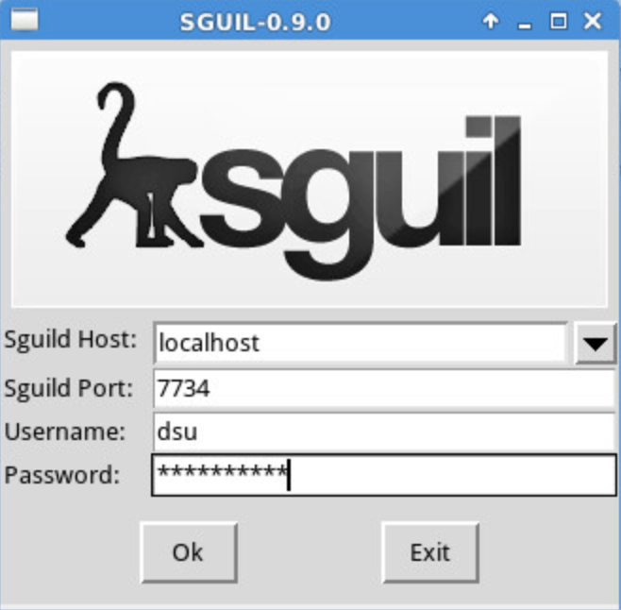
Sguil
Collects, stores, and presents data
Some other tools in SO use this data
Some other tools rely on Sguil
Client/Server application
Client link on the desktop of SO
Sguil works with data collected from a live interface
Can’t open a historical pcap
Select all networks to monitor

Slide 12
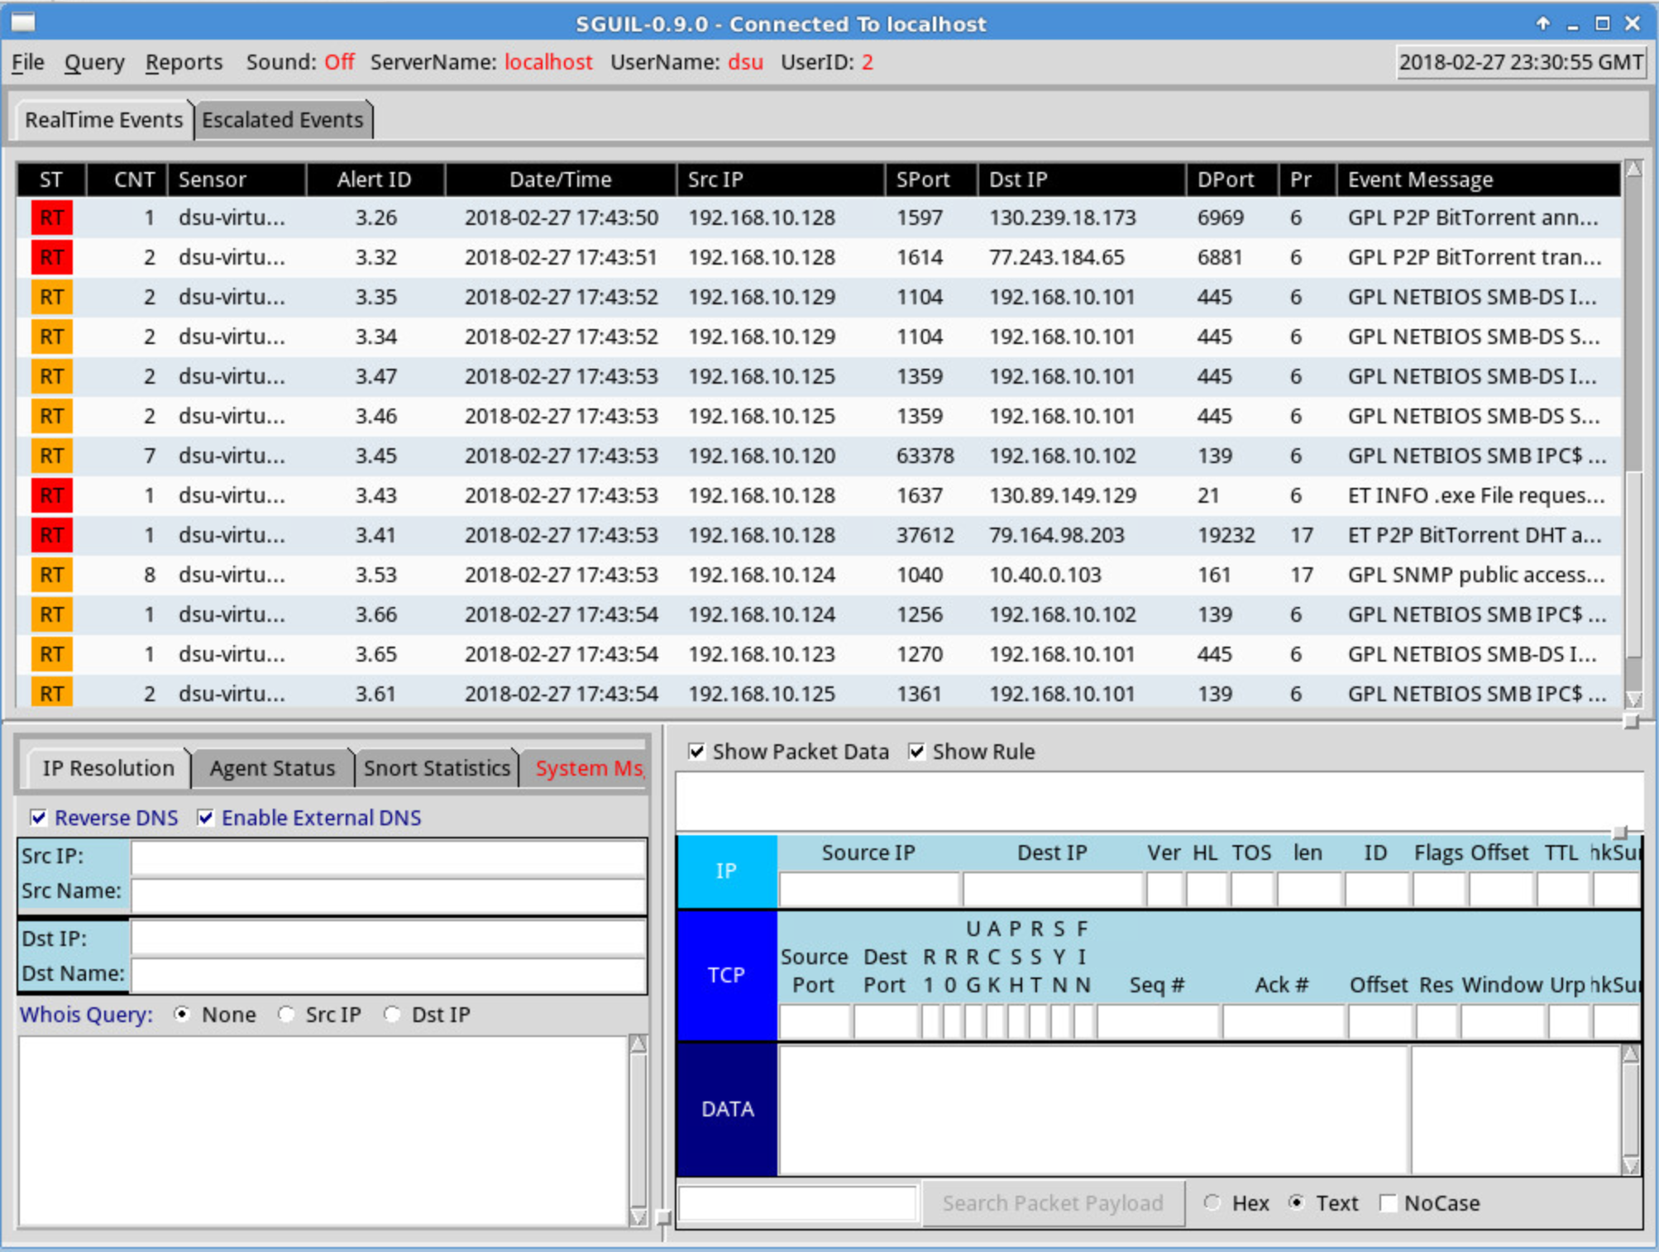
Showing Data
Check…
Reverse DNS
Show Packet Data
Show Rule

Slide 13
Sguil
Aggregates similar alert data records
Note the count field
Makes certain types of metadata readily available
Like reverse DNS
Allows you to query and view alert data
Allows you to query and view session data
Lets you pivot into full content data
Right click menu
Allows you to count and classify events

Slide 14
Alert Data in Sguil
Sguil calls alerts “event data”
Event == alert
Sguil shows alert data from…
Snort
Suricata
OSSec
Can search for events
Query -> Query Event Table

Slide 15
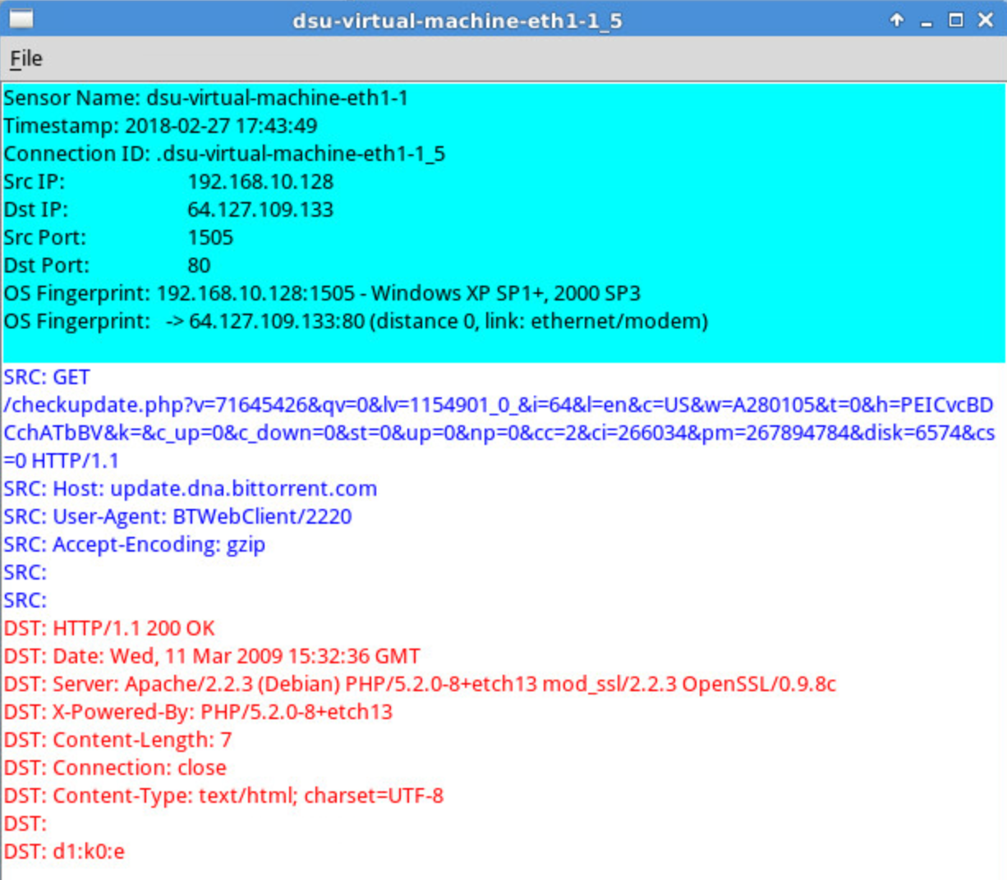
Full Content Data
Alerts are useful in kicking off an investigation
Not going to give you all the juicy details
You’ll often pivot from the alert to something else
Session data
Full content data
Right click on an alert ID
Select Transcript
Shows everything during that specific session
Also can open the session in Wireshark

Slide 16
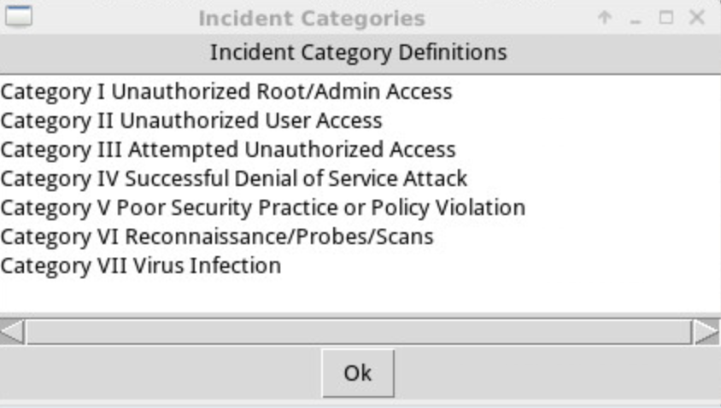
Categorizing Events
Sguil is very much meant to be a first line tool in a SOC
Meant to be actively monitored
The RealTime events tab shows new events that have not been looked at
When you make a determine on an alert, classify it
Set an appropriate category
Right click on category status, Update Event Status
Categories can be changed to something that makes sense for your org/workflow
File -> Display Incident Categories

Slide 17
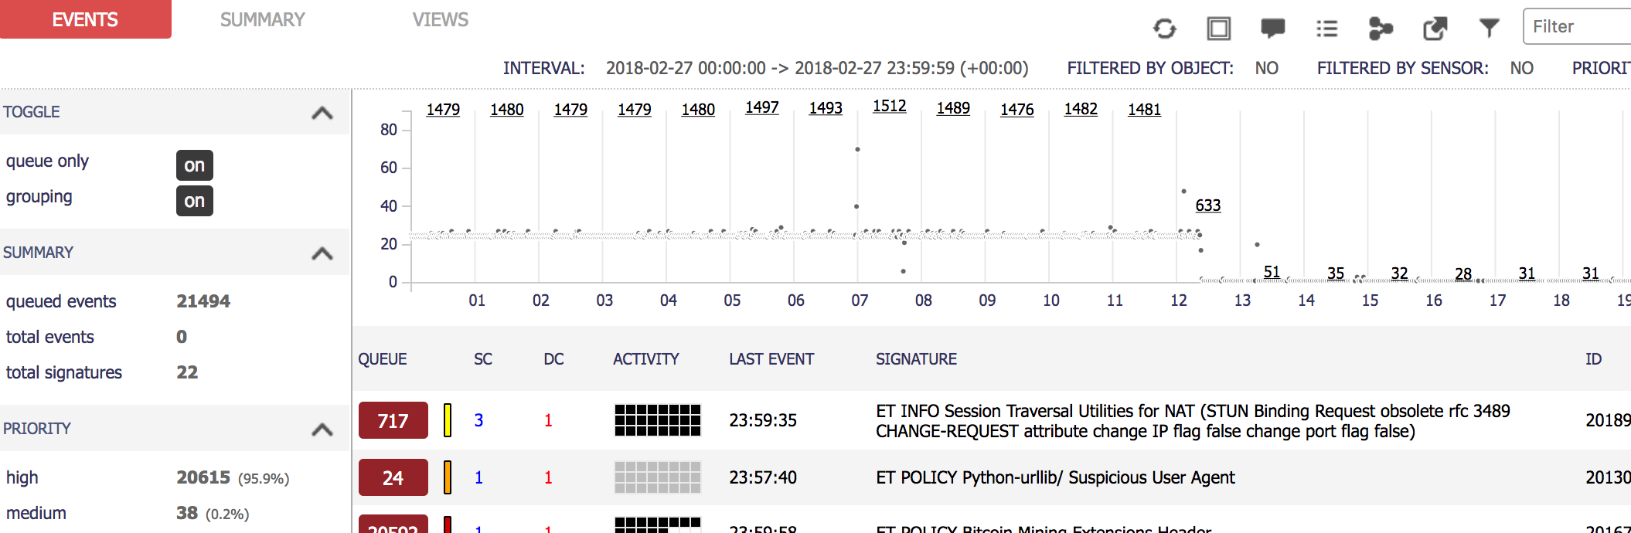
Squert
Squert provides access to Sguil’s databases through a web browser
Has a few more visualizations
Also has a few more pivoting options
http://localhost/squert

Slide 18
CapME
Web-based pcap viewer
Uses tcpflow to render
Download pcap

Slide 19
Cyber Chef
“The Cyber Swiss Army Knife”
Various cyber things…
Encoding
Encryption
Hash calculation
X.509 parsing
Etc
Data manipulation

Slide 20
Analysis Tools – Elastic Stack
Elasticsearch, Logstash, Kibana – ELK, Elastic Stack
Store, search, and visualize data
Logstash – stores log data
Elasticsearch – searches log data
Kibana – dashboards and visualizations

Slide 21
Deployment Scenarios
Security Onion is setup in two parts: a sensor and a server
Client-Server model
The sensor is the client – sends information back to the server
Sensors can be placed throughout the network for additional visibility
Server stores information, and includes analysis tools for processing
The analyst logs in to the server
Three deployment scenarios
Standalone
Server-sensor
Hybrid

Slide 22
Deployment Scenarios - Standalone
A single machine running the sensor and server components
Can be a physical machine or a VM
Can have multiple network interfaces for monitoring different networks
Easiest deployment for monitoring at a single location

Slide 23
Deployment Scenarios – Server-sensor
A single machine runs the server component
One or more separate machines run the sensor component
Sensors report back to the central server
Sensors run the sniffing, and store packet captures, alerts, and databases
Analyst connects to the server
Queries are distributed to the appropriate sensors
Reduces network traffic, keeping the bulk of the data on the sensors

Slide 24
Deployment Scenarios - Hybrid
Standalone installation
Server and sensor combination
…with one or more additional sensors reporting back to the server

Slide 25
Hardware Requirements - Server
If you’re running just the server, requirements are down
Intensive processing is left to the sensors
1-4 CPU cores
8-16gB RAM
100GB to 1TB of disk space

Slide 26
Hardware Requirements - Sensor
Snort, Suricata, and Bro are very CPU intensive
The more traffic, the more CPU cores you’ll need
CPU - One core per worker
200Mbps per Snort, Suricata, or Bro worker
Fully saturated 1Gbps link with Snort and Bro?
10 cores (5 Snort workers, 5 Bro workers)
RAM – It depends on traffic
Minimum – 3GB
50Mbps link – 8GB+
50-500Mbps link – 16GB – 128GB
Storage – Full packet capture takes a lot of space
50Mbps link, 540GB for one day of pcap
Store for as long as you can – useful for investigations after the fact
ELSA will need space too

Slide 27
Sguil Lab
It seems a few systems accessed TeamViewer. What systems were those (IP Addresses) and what was the full URL that was visited?
What operating system is running at 10.59.103.66?
What alert was most frequent, and how many times did it fire?
There was an alert for suspicious inbound to a MySQL port. What actually happened during this connection?

Slide 28

Sguil Lab
It seems a few systems accessed TeamViewer. What systems were those (IP Addresses) and what was the full URL that was visited?
10.59.103.104 and 10.59.106.107
What operating system is running at 10.59.103.66?
Windows Server 2016 Standard (Transcript of IPC$ Share Access)
What alert was most frequent, and how many times did it fire?
ET SCAN NMAP OS Detection Probe, 280 times
There was an alert for suspicious inbound to a MySQL port. What actually happened during this connection?
Scanned for version, login as root.

Slide 29
Security Onion Tools
Many tools ship with Security Onion
https://securityonion.readthedocs.io/en/latest/Tools.html
Some are for collecting data from the network or other computers
Some are for presenting information to analysts
Some blur those lines

Slide 30
Data Presentation Tools
Expose network security monitoring information to analysts
Some are Command Line tools
Some have a GUI
Packet Analysis Tools - read traffic from a live interface or a file
CLI Tools
Tcpdump, tshark, argus, ra
GUI Tools
Wireshark, Xplico, NetworkMiner
NSM Consoles – built with NSM investigation workflows in mind
Sguil, Squert, Elastic

Slide 31
Data Collection Tools
Collecting and generating NSM data for the presentation tools
Session data
Argus, PRADS (Passive Real-Time Asset Detection System)
Full content data
Netsniff-ng
IDS
Bro, Snort, Suricata

Slide 32
Data Delivery Applications
Sit between data collection and data presentation
A sort of middleware
Manage IDS rules, alerting, and pcap access
PulledPork, Barnyard2, CapMe
Managing host-based analysis features
OSSEC IDS
Syslog-ng

Slide 33
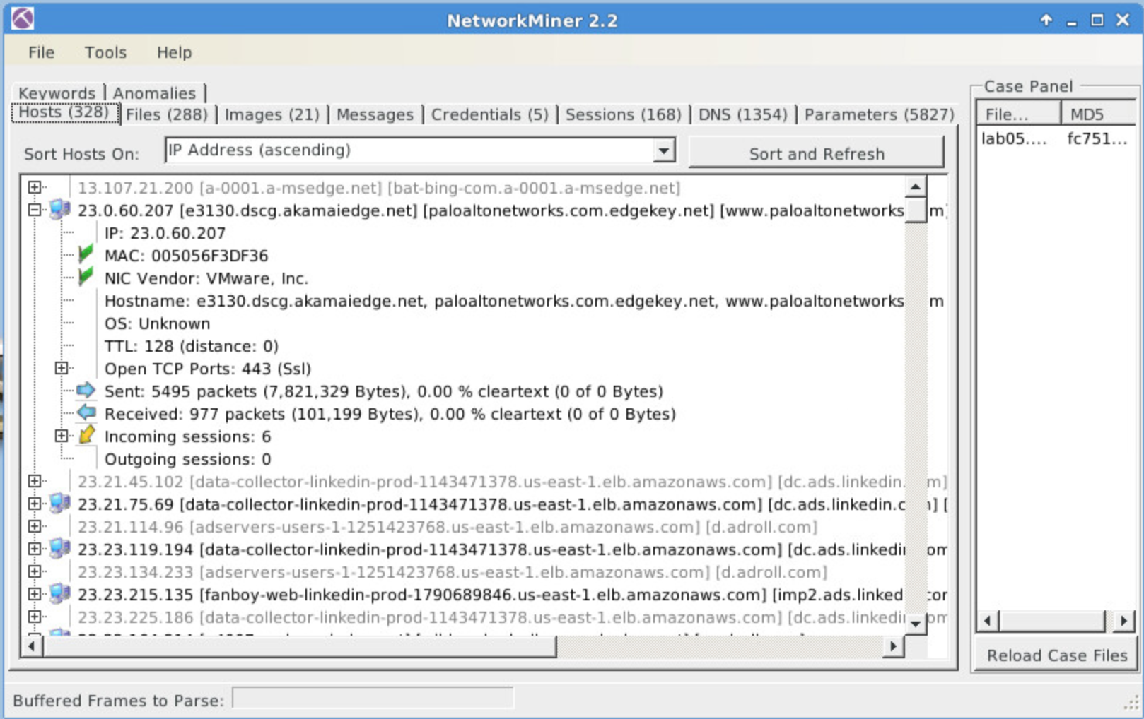
Network Miner
Network Forensic Analysis Tool for Windows
But they made it work on SO with Mono
Can sniff live traffic, or use captured pcaps
When you open a pcap, NetworkMiner will begin analysis
If the pcap is large, this could take a while
Will extract various information
Hosts
Files
Images
Session Information
And more

Slide 34
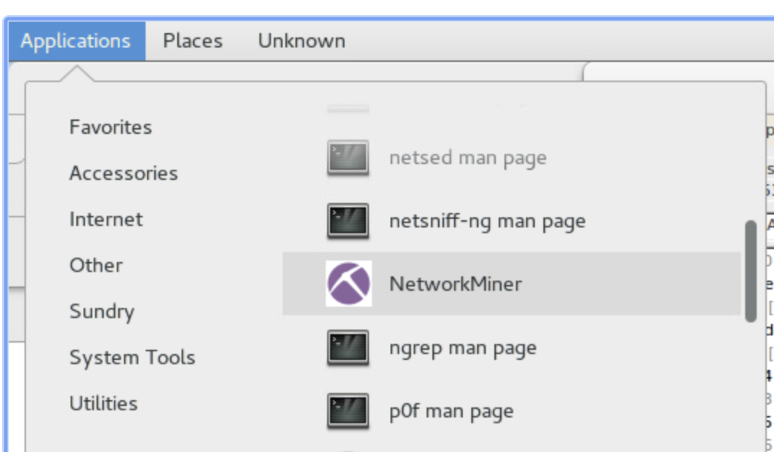
Network Miner Lab
Setup…
Walkthru.pcap

Slide 35
Network Miner Quick Lab
Walkthrough.pcap
Provide details about the following IP address: 138.247.115.240
DNS Name:
Open port:
How many packets were sent?
Were any plaintext user and password credentials that were extracted?
What are most of the file types that were transferred over the network?

Slide 36
Network Miner Quick Lab
Provide details about the following IP address: 138.247.115.240
DNS Name: share.ialab.dsu.edu
Open port: 80
How many packets were sent? 656
Were any plaintext user and password credentials that were extracted?
No
What are most of the file types that were transferred over the network?
Certificate files

Slide 37
SIEM

Slide 38
So many logs
Logs are extremely useful – essential to a good security monitoring program
Need a way to efficiently collect, store, and analyze logs
Log aggregation utility, SIEM
Needs to be able to handle LOTS of logs quickly and efficiently
Keep in mind the quantity of logs you may be dealing with!
Tens or hundreds of thousands of events per machine (or more)
Imagine a company with 100-1000 computers (not actually that big)
Easily in the millions of events each day (or more)

Slide 39
SIM, SEM, SIEM
All are tools that collect information used to analyze the security of the network
SIM – Security Information Management
Typically collecting logs
The raw information
SEM – Security Event Management
Holds a collection of events
Suspicious authentications, logon to admin account after hours, etc.
Summarized “event” information from the raw security information
SIEM – Security Information Event Management
Combination of the above two
Raw information from logs
Security events

Slide 40
They are quite similar
All really started with SIM tools
Start collecting logs from various systems
Often helps meet compliance requirements
So you have a bunch of logs, now what?
SEM systems help provide analysis and visualization capabilities
Real-time
Analyze alerts
SIEM combines this – most products today should have the combined capabilities
Very few folks draw a distinction between these anymore – basically the same

Slide 41
Capabilities
Data Aggregation
Consolidates logs from many sources
Correlation
Uses common attributes to link events together
Turns raw data into more useful information
Alerting
Automated analysis of raw data produces actionable alerts
Dashboards
Turns data into useful charts
Easier to see patterns or anomalies in data
Compliance
Produce reports from log data for compliance requirements
Retention
Long-term storage for forensic investigations and possible compliance requirements
Forensic Analysis
Ability to search across different nodes and time periods.

Slide 42
Plenty of options
Lots of vendors in the market
Orgs should evaluate products and make selections based on their needs
Which features from the previous slide are 100% necessary?
Price
Learning curve
Quantity of data and server requirements
As an incident responder, you may use any number of these – whatever is available to you
Some vendors in the market…
IBM, Splunk, HPE, AlertLogic, Intel, LogRhythm, ManageEngine, MicroFocus, Solar Winds, Trustwave…
Even some open source options
OSSIM, Elastic Stack, Apache Metron, SIEMonster, Prelude, Graylog

Slide 43
Graylog
Open source log
Open source log management
Scalability
Can bring in logs from multiple tools from multiple systems
Terabytes of data
Alerting capabilities
Report generation capabilities
Pre-configured appliance for testing
Production, more scalable setups on Ubuntu, Debian, CentOS

Slide 44
Elastic
Logstash
Data Collection
Elasticsearch
Data Storage, Searching
Kibana
Data Presentation, Dashboards, Visualizations
Remember, this is included on Security Onion!

Slide 45
Elastic in SO
Demo/walkthrough

Slide 46
Bro Lab

